Slide 1
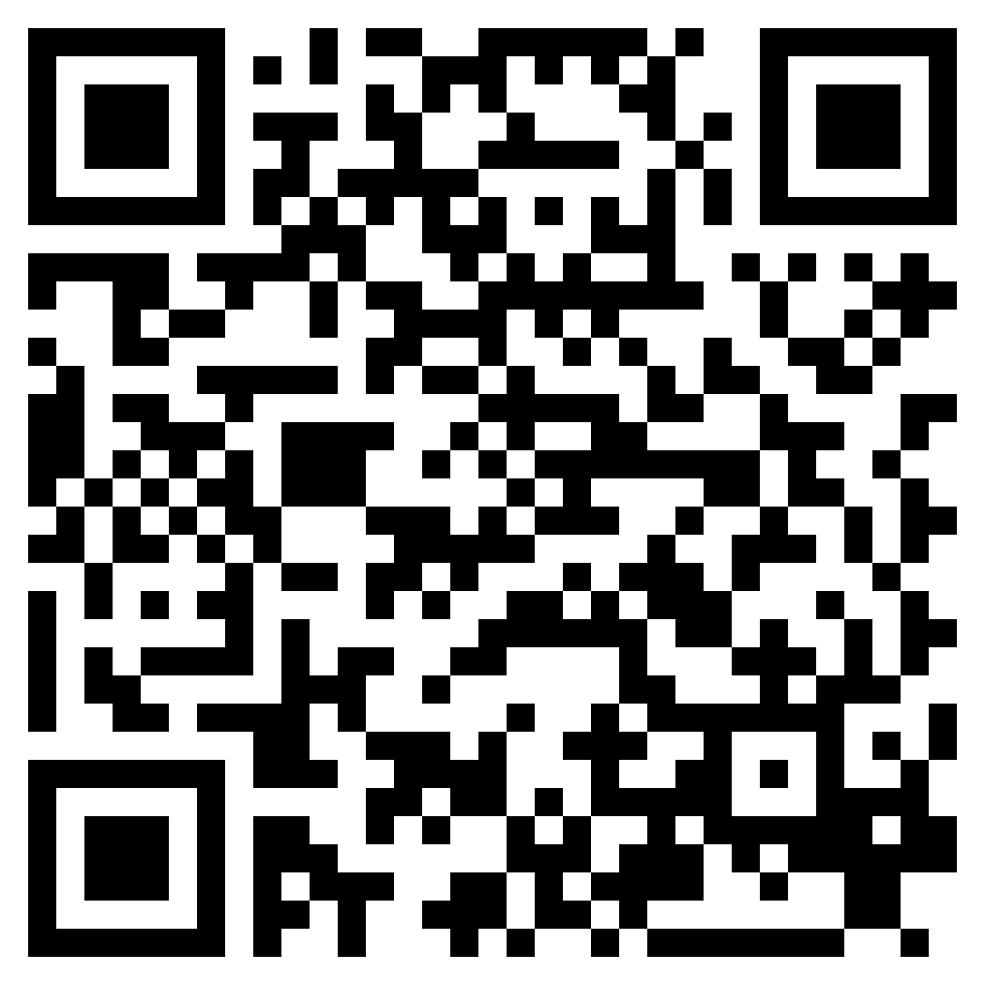
DEFENDING THE KINGDOM, PART 1
ACTS 22

Slide 2
“Men of Israel, help! This is the man who is teaching everyone everywhere against the people and the law and this place. Moreover, he even brought Greeks into the temple and has defiled this holy place.”
(Acts 21:28, ESV)

Slide 3
Defense against the charge of speaking against the Law (vss. 1-5)
Defense against the charge of speaking against ”this place” (vss. 6-16)
Defense against the charge of speaking against the people (vss. 17-21)
PAUL’S DEFENSE (ACTS 22.1-21)

Slide 5
Give good arguments, not insults
Give the information necessary to reach the right conclusions
Remember that Jesus is the judge, not the audience
DEFENDING THE KINGDOM

Slide 6
DEFENDING THE KINGDOM, PART 1
ACTS 22

