Slide 1
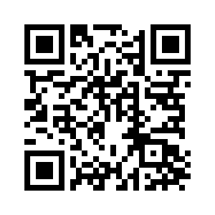
CHAPTERS 9-10

Slide 2
9.1-17, God’s Covenant With Man
Genesis 9:4–6 (ESV)
⁴ But you shall not eat flesh with its life, that is, its blood. ⁵ And for your lifeblood I will require a reckoning: from every beast I will require it and from man. From his fellow man I will require a reckoning for the life of man. ⁶ “Whoever sheds the blood of man, by man shall his blood be shed, for God made man in his own image.

Slide 3
9.1-17, God’s Covenant With Man
God establishes the covenant (vs. 9)
God determines who will benefit from the blessings of the covenant (vss. 9-10)
God alone can fulfill the promises of the covenant (vs. 11)
God gives the sign of the covenant offering assurance that it will be kept (vss. 12-17)

Slide 4
9.18-29, The Sons of Noah
Genesis 9:25–27 (ESV)
²⁵ he said, “Cursed be Canaan; a servant of servants shall he be to his brothers.” ²⁶ He also said, “Blessed be the Lord, the God of Shem; and let Canaan be his servant. ²⁷ May God enlarge Japheth, and let him dwell in the tents of Shem, and let Canaan be his servant.”

Slide 5
