Slide 1
CHAPTERS 13-14

Slide 2
13.1-13, Abram & Lot Separate
Abram returns from Egypt to Bethel
An emerging problem:
V6 – “And the land could not sustain them while dwelling together”
How does Abram handle this problem?
V8-9 – “Please let there be no strife between you and me… Is not the whole land before you? Please separate from me…”
Notes:
After getting escorted out of Egypt, Abram goes back to Bethel, and to the area where he had been previously – back to the altar he built and called upon the Lord. What do you think might be significant about this?
- This was the place he first called upon the Lord, and perhaps after the experience in Egypt, this could have re-grounded him and refreshed his faith.
Who was with him? His wife, all their possessions (v1-2 mentioned here that he was very rich in livestock, silver and gold), along with Lot and all his possessions (v5 - flocks, herds, tents).
A problem arises here – what is it?
They were becoming too crowded on the land – they had too many possessions and their herdsmen were causing strife with the other. (v7)
We also don’t know if the famine mentioned in Chapter 12:10 had ended. This could have added to the concern/problem with limited resources to support both herds.
The end of verse 7 has a sentence “Now the Canaanite and the Perizzite were dwelling then in the land.” Why do you think this is mentioned?
There were also others trying to live off the same land
Others could have been aware of the growing problem between the herdsmen of Abram and Lot – it needed to be solved and would likely reflect poorly on Abram and Lot.
How does Abram handle this problem? Verses 8-9 – “So Abram said to Lot, ‘Please let there be no strife between you and me, nor between my herdsmen and your herdsmen, for we are brothers. Is not the whole land before you? Please separate from me; if to the left, then I will go to the right; or if to the right, then I will go to the left.’”
What impresses you about this solution by Abram?
He approaches Lot humbly – starts with “please” and uses twice.
Asks for Lot’s help in making for peace
Made Lot his equal – “we are brothers” when Abram was his uncle, seemed to be richer, older and could probably have dictated the outcome to Lot.
Gave Lot first choice/pick – showed deference to Lot’s desire.
Why would Abram approach the situation this way?
- Avoids conflict with Lot, or in disappointment/resentment from Lot in Abram choosing for him.
Continued trust in the Lord to provide
Continued trust in the Lord’s promises to Abram
Gets away from Abram trying to solve/outsmart the problem (like in Egypt)
How did Lot choose?
“Lifted up his eyes”, saw the well-watered valley of the Jordan (v10)
Chose the beautiful/fertile land – the best for himself
So Lot headed east.
This choice has serious consequences, foreshadowed in v12-13 – “Lot settled in the cities of the valley, and moved his tents as far as Sodom. Now the men of Sodom were wicked exceedingly and sinners against the Lord.”
We will talk about things that happen to Lot a bit later in this class and in future classes, but we have Lot making a decision based on what he saw was pleasant and desirable. Where else have we talked about people get drawn away from God by what they see? The people of Noah’s time (“sons of God”) marrying “daughters of men” based on physical appearance/beauty.
And in Lot choosing to go east, Abram settles in Canaan.

Slide 3
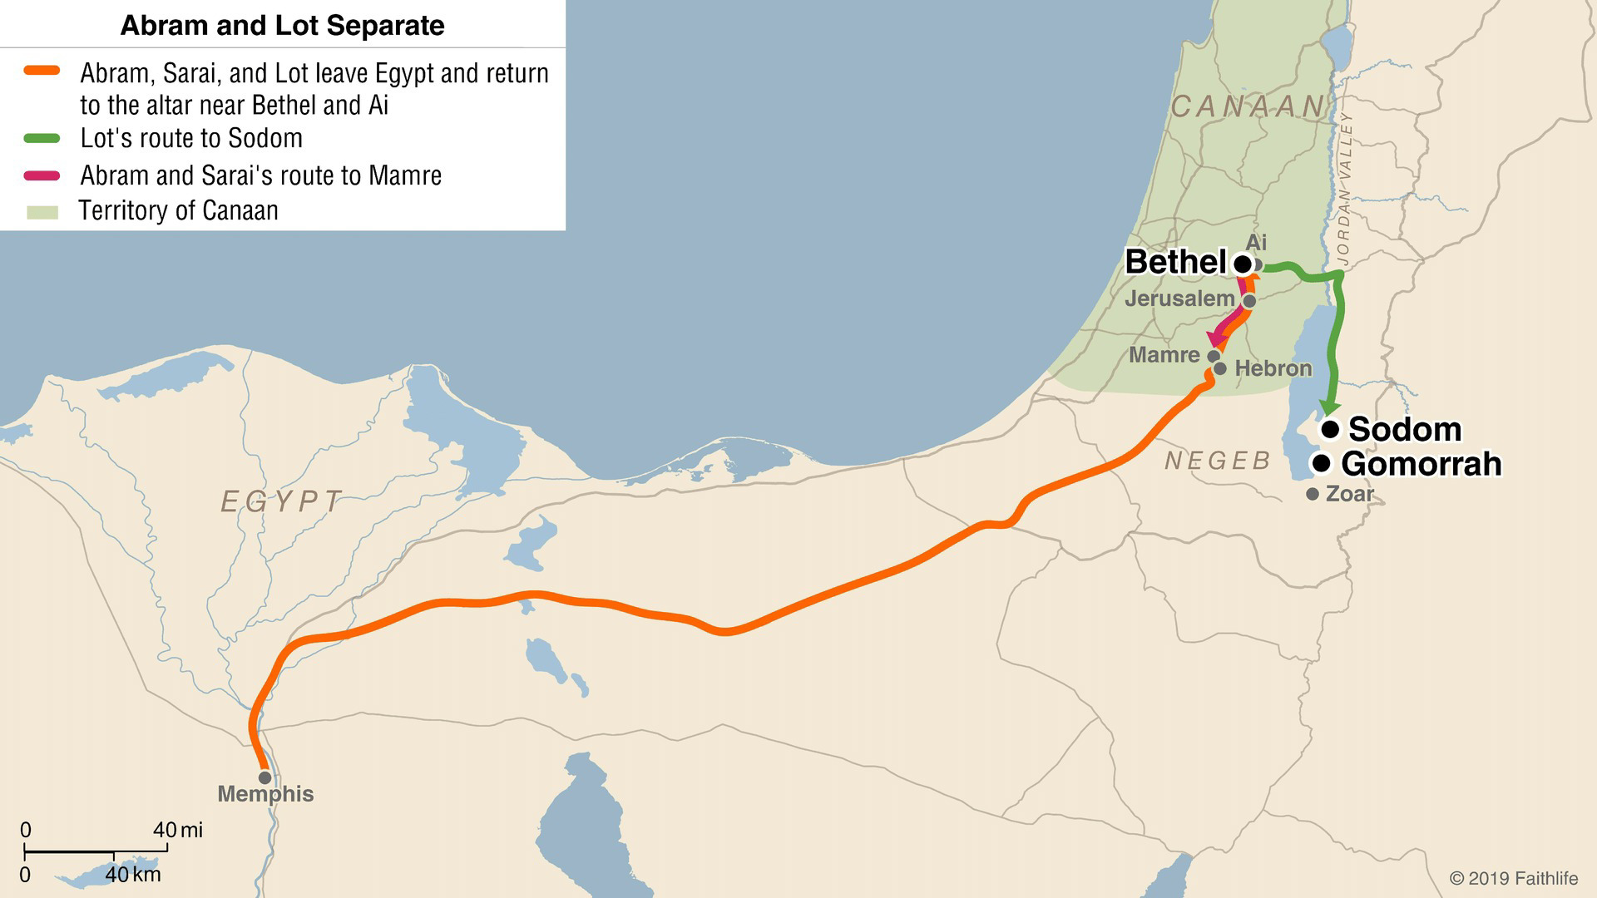
13.1-13, Abram & Lot Separate
Notes:
Here’s a map that might help visualize these choices and where they each settled.
Let’s take a brief look at what God says to Abram after departing from Lot.
V14 – “Now lift up your eyes and look…” . This is an interesting comparison to Lot and how Lot chose which way to go (“v10 – Lot lifted up his eyes and saw”). What do you think this shows us? Abram is walking by faith, whereas Lot was by sight.
V15 – “Look from the place where you are, northward and southward and eastward and westward; for all the land which you see, I will give it to you and your descendants forever.” God already told Abram this in 12:7 - why say it again in 13:15?
Consider the relationship Abram and Lot had. Lot’s father Haran had died, and Lot had made the journey with Abram to Canaan. Sarai was barren, so Abram had no children of his own. Its possible Abram considered Lot his adoptive heir.
God chooses this moment, after Lot has departed, to confirm His promises to His servant, Abram. Lot would have no part in this promise – Abram and his descendants would.
God tells Abram to “walk about the land through its length and breadth; for I will give it to you.” v17. Abram does so and moves his tents south to Hebron and (again) builds an altar to the Lord.

Slide 4
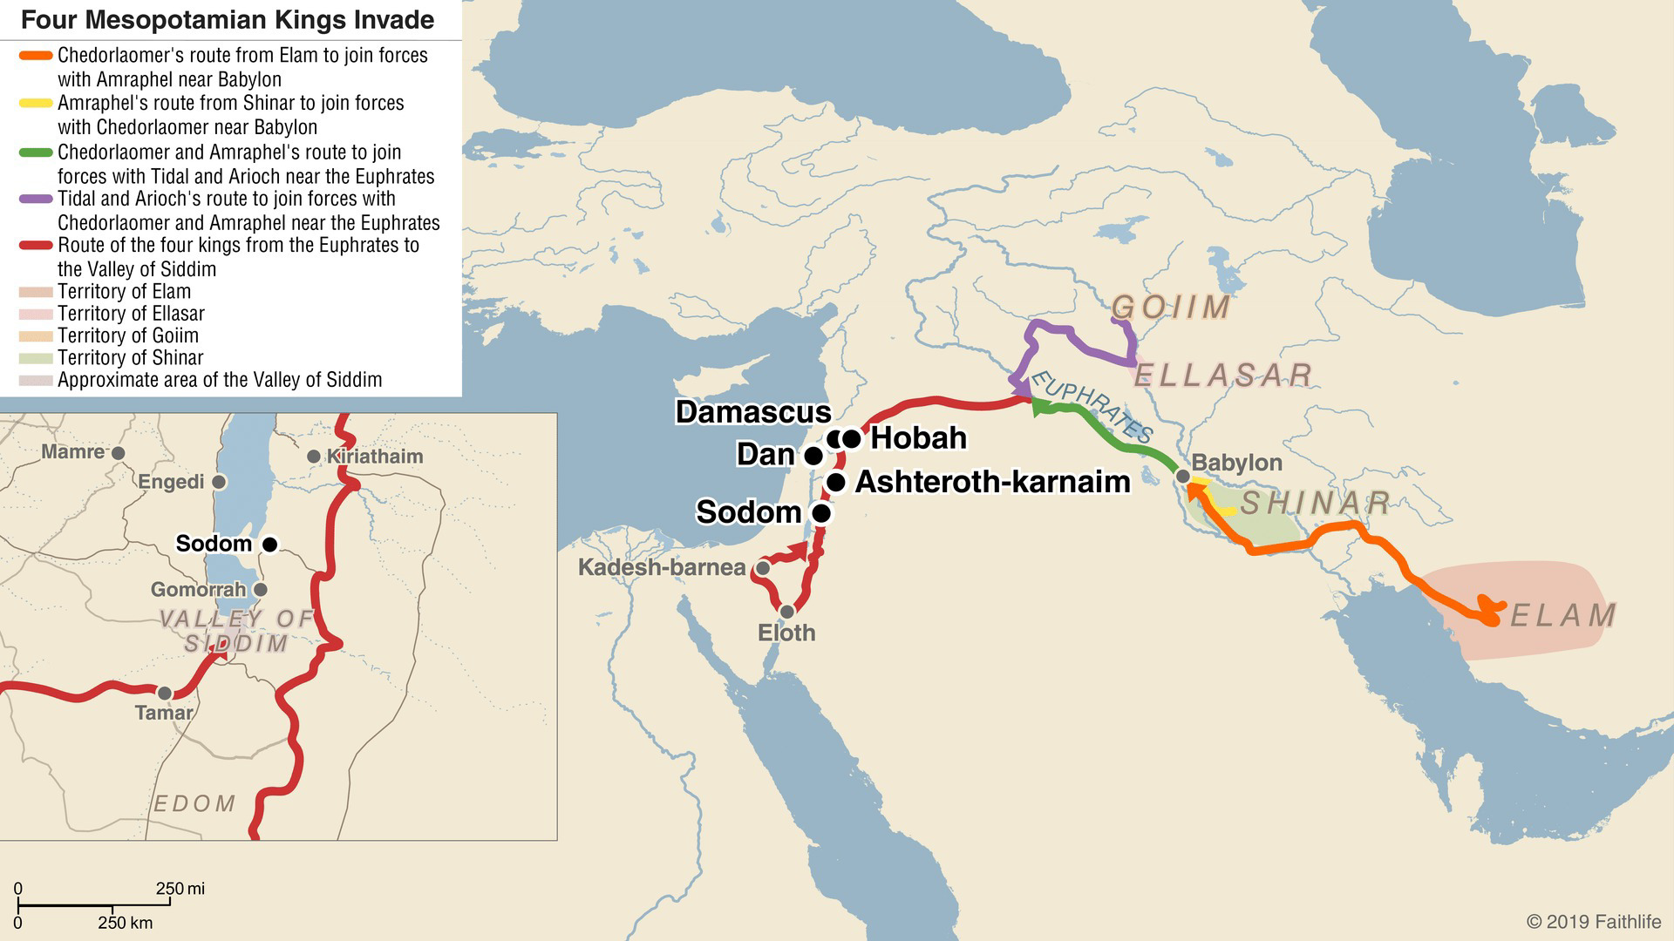
14.1-12, Four Kings Against Five
Notes:
Chapter 14 starts out with the description of an oppression, which leads to a war brewing and threatening the people in nearby lands. Let’s put up a map to help visualize what is going on. By the way, this is the first time that we see biblical events expressly coordinated with external history.
You have 4 kings (or warlords – they did not rule empires, but city-states) from the eastern lands – Amraphel (Shinar), Arioch (Ellasar), Chedorlaomer (Elam), Tidal (Goiim). They had been slowly moving westward and oppressing lands by force as they branch out away from their region. They had oppressed the 5 kings near where Abram and Lot have been for 12 years, and in the 13th year of this oppression, they rebelled against it. In year 14, the 4 kings from the east would respond with force.
These 5 kings who became allies were to fight against the 4 from the east are – Bera (Sodom), Birsha (Gomorrah), Shinab (Admah), Shemeber (Zeboiim), and king of Bela/Zoar. This battle was to take place in the valley of Siddim – where Sodom and Gomorrah were. By the way - the names of the kings of Sodom and Gomorrah, Bera and Birsha, are compounds of the words “evil” and “wicked”, respectively. Another reinforcement that these were not places Lot should want to be. Anyways…
These 4 invading kings end up taking Sodom and Gomorrah. The two kings of Sodom and Gomorrah fled and fell into some tar pits, while others who survived scattered into the hills. The invading kings take all the goods from the cities, their food, and left – also taking Lot and his possessions, since he was in Sodom.
But in verse 13, we see a fugitive gets to Abram and tells him what happened.

Slide 5
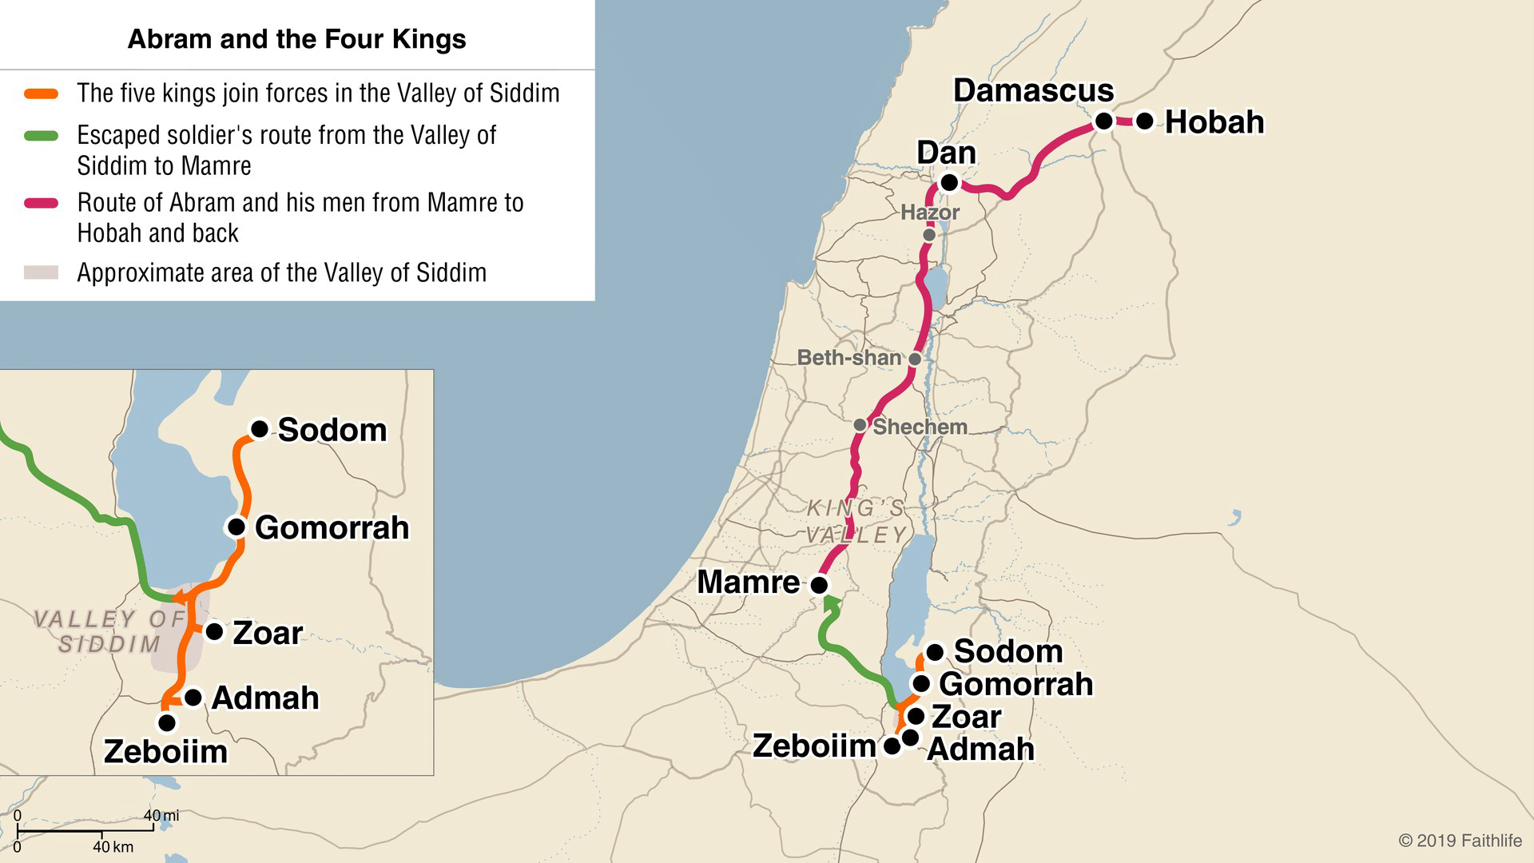
14.13-16, Abram Rescues Lot
Notes:
So Abram takes trained men from his house – 318 of them. And pursues these captors as far as Dan. Which we can see from this map looks to be about 100 miles (according to scale).
And when he gets close, he divides up his forces, attacks at night, and defeats them – even going as far as Hobah, which looks to be another 40+ miles further.
They are victorious, and Abram brings back all the goods, Lot & his possessions and the women and the people that were taken.
What might you take from this story of Abram rescuing Lot?
Abram cares for Lot still, even thought they are not together, and Lot has surrounded himself in bad circumstances
What the people of Sodom and Gomorrah (and all the cities before them) could not defend against, Abram and his 318 defeated – which ultimately shows the power of God
Upon his return, he’s met in the King’s Valley by two kings.

Slide 6
14.17-24, Abram and the two kings
Salem
Melchizedek
Bread & Wine, Blessing
Gives him a tenth of all
City
Name
Offers Abram
Abram’s response
Sodom
unnamed
All the goods recovered
Strongly rejects
Notes:
Let’s compare the two kings and how Abram dealt with them.
King of Salem (also known as Jerusalem), named Melchizedek, brings out bread and wine to Abram. He’s also described as priest of God. He blesses Abram and praises God, while asking for nothing in return. How does Abram respond to him? He gave him a tenth of all – clearly showing respect and deference to one who was superior to him.
The king of Sodom, who was unnamed (remember the previous king of Sodom fell into the tar pits with the king of Gomorrah), offers Abram all the goods recovered in exchange for the people. How does Abram respond? V22-24 – “Abram said to the king of Sodom, ‘I have sworn to the Lord God Most High, possessor of heaven and earth, that I will not take a thread or a sandal thong or anything that is yours, for fear you would say ‘I have made Abram rich.’ I will take nothing except what the young men have eaten, and the share of the men who went with me, Aner, Eschol, and Mamre; let them take their share.’”
What would you say about Abram here? What strikes you?
Strongly rejected one associated with evil
Content in what the Lord had and would provide for him
Aligned with/showed respect to the king aligned with God.
Much different response from when Abram accepted the gifts from Pharoah in Chapter 12.
I want to spend a little bit of time on this King of Salem, Melchizedek.

Slide 7
Melchizedek
King of Salem (“peace”), “King of righteousness”
Gen 14:18 - “Priest of the God Most High”
v3 – “without genealogy”
v3 – “made like the Son of God”
v4 – “great”, v7 – “greater than Abraham”
v8 – “even Levi, who received tithes, paid tithes”
Gave bread and wine to Abram
Notes:
Melchizedek is an interesting character – he’s talked about more retrospectively than he is in the Genesis story.
First, he was the King of Salem – what does that translate to? King of peace
The name of Melchizidek – do we know the translation of his name? King of righteousness
And Melchizedek was not only a king, but also a priest of God Most High.
So who is Melchizedek pointing us towards? Jesus
Melchizedek is mentioned again in the prophecy of Psalms 110 that would be fulfilled in Jesus. Verse 4 – “The Lord has sworn and will not change His mind, ‘You are a priest forever according to the order of Melchizedek.”
In Hebrews 7, the writer goes into more detail about Melchizedek and his priesthood and the fulfillment of the Psalms prophecy in Jesus. Let’s turn to Hebrews 7.
What else do we learn about Melchizedek here, and the comparison to Jesus?
v1 – He held the title of king and priest of the Most High God – like Jesus. Aaron and the priests of the tribe of Levi would not have the titles of both king and priest.
v3 – His lineage is not known/traced. Why would this matter? His priesthood was not established by the circumstances of his birth and descent. It was based on God calling him – just like Jesus. Jesus was not from the tribe of Levi – which one was he from? Judah.
v3 – Melchizedek was made like Christ, not the other way around. I think Melchizedek being mentioned first in the comparison can hang us up, as can the phrase “according to the order of” – which means of “the same manner”, having “similar conditions” or “properties”. Here’s a quote from one commentator that may help – “The writer says that Melchizedek is “made like” the Son of God, not that the Son of God is like Melchizedek. Thus it is not that Melchizedek set the pattern and Jesus follows it. Rather, the record about Melchizedek is so arranged that is brings out certain truths that apply far more fully to Jesus than they do to Melchizedek.” (Leon Morris, Expositors Bible Commentary)
V4,6 – Superior to Abram in that Abram gave him a tenth of the spoils.
V6-7 – Melchizedek blessed Abram, the one who had the promises. The greater blesses the lesser.
V8 – Even Levi, who received tithes, paid tithes to Melchizedek (“so to speak”) through Abram his ancestor. The priests of the tribe of Levi would receive tithes from the people – how much more is it that Levi effectively paid tithes to Melchizedek?
And the rest of Hebrews 7 goes on to establish that Christ’s priesthood is far superior to the Levitical priesthood. But the foundation for the people understanding that was laid back in Genesis 14.
One other note of interest – Melchizedek gave bread and wine to Abram, which are the same elements Christ commemorated what He gives to us.

