Slide 1
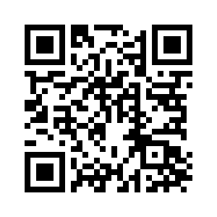
CHAPTER 17

Slide 2
Covenant & Circumcision
Genesis 17:1–2 (ESV)
¹ When Abram was ninety-nine years old the Lord appeared to Abram and said to him, “I am God Almighty; walk before me, and be blameless, ² that I may make my covenant between me and you, and may multiply you greatly.”

Slide 3
Covenant & Circumcision
Genesis 17:4–5 (ESV)
⁴ “Behold, my covenant is with you, and you shall be the father of a multitude of nations. ⁵ No longer shall your name be called Abram, but your name shall be Abraham, for I have made you the father of a multitude of nations.

Slide 4
Covenant & Circumcision
Genesis 17:10–11 (ESV)
¹⁰ This is my covenant, which you shall keep, between me and you and your offspring after you: Every male among you shall be circumcised. ¹¹ You shall be circumcised in the flesh of your foreskins, and it shall be a sign of the covenant between me and you.

Slide 5
Covenant & Circumcision
Circumcision WAS point of entry and sign
Circumcision WAS NOT how Abraham was found righteous
Circumcision WAS NOT how God would bless all famlies

Slide 6
Isaac’s Birth Foretold
Genesis 17:17–19 (ESV)
¹⁷ Then Abraham fell on his face and laughed and said to himself, “Shall a child be born to a man who is a hundred years old? Shall Sarah, who is ninety years old, bear a child?” ¹⁸ And Abraham said to God, “Oh that Ishmael might live before you!” ¹⁹ God said, “No, but Sarah your wife shall bear you a son, and you shall call his name Isaac. I will establish my covenant with him as an everlasting covenant for his offspring after him.

Slide 7
Abraham’s Obedience
Genesis 17:23 (ESV)
²³ Then Abraham took Ishmael his son and all those born in his house or bought with his money, every male among the men of Abraham’s house, and he circumcised the flesh of their foreskins that very day, as God had said to him.

