Slide 1
CHAPTER 19

Slide 2
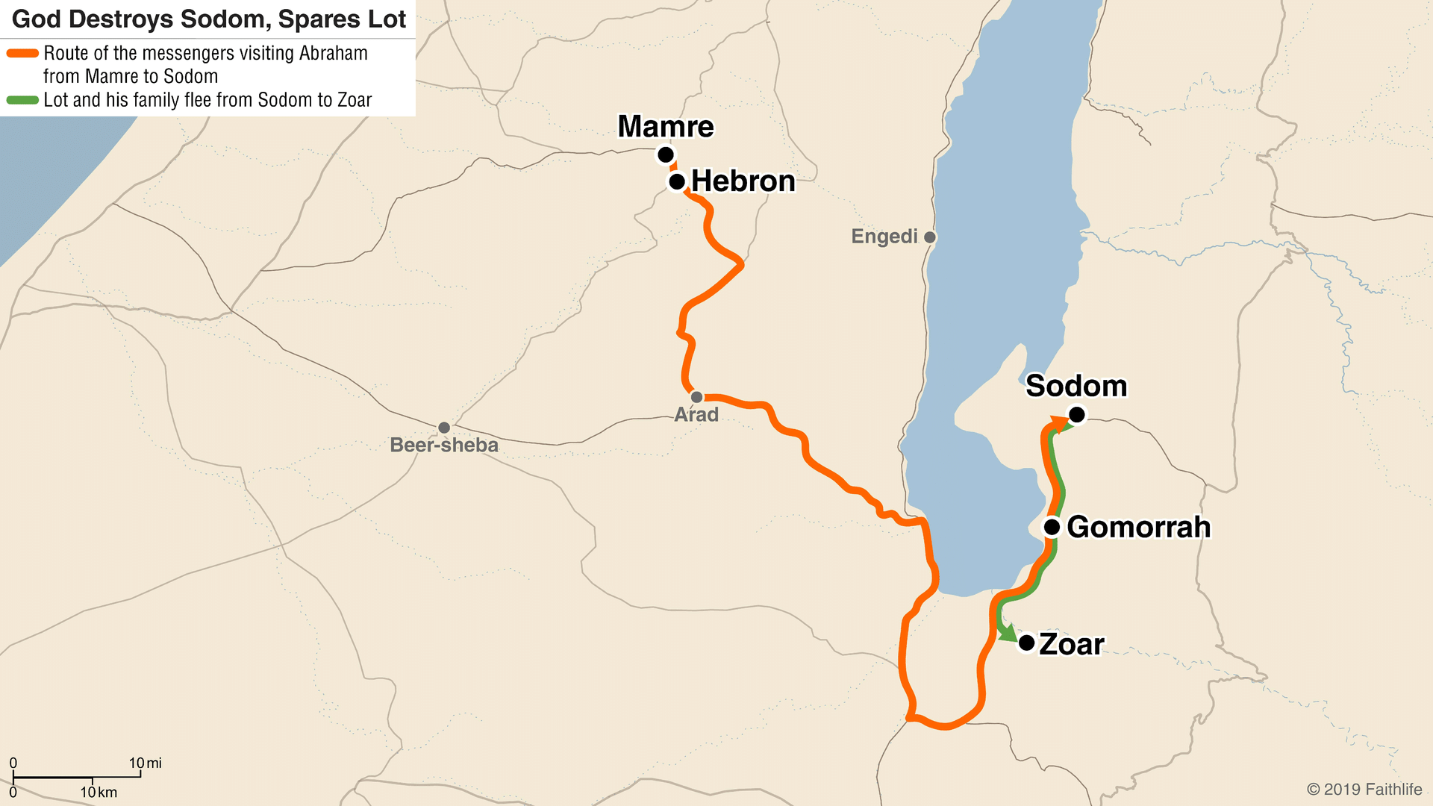
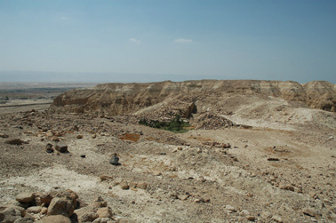
Setting for Chapter 19

Slide 3
CHAPTER 19 – God Rescues Lot
Genesis 19:4-7 (ESV)
4 But before they lay down, the men of the city, the men of Sodom, both young and old, all the people to the last man, surrounded the house. 5 And they called to Lot, “Where are the men who came to you tonight? Bring them out to us, that we may know them.” 6 Lot went out to the men at the entrance, shut the door after him, 7 and said, “I beg you, my brothers, do not act so wickedly.

Slide 4
CHAPTER 19 – God Rescues Lot
Genesis 19:9-11 (ESV)
9 But they said, “Stand back!” And they said, “This fellow came to sojourn, and he has become the judge! Now we will deal worse with you than with them.” Then they pressed hard against the man Lot, and drew near to break the door down. 10 But the men reached out their hands and brought Lot into the house with them and shut the door. 11 And they struck with blindness the men who were at the entrance of the house, both small and great, so that they wore themselves out groping for the door.

Slide 5
CHAPTER 19 – God Rescues Lot
Genesis 19:12-14 (ESV)
12 Then the men said to Lot, “Have you anyone else here? Sons-in-law, sons, daughters, or anyone you have in the city, bring them out of the place. 13 For we are about to destroy this place, because the outcry against its people has become great before the Lord, and the Lord has sent us to destroy it.” 14 So Lot went out and said to his sons-in-law, who were to marry his daughters, “Up! Get out of this place, for the Lord is about to destroy the city.” But he seemed to his sons-in-law to be jesting.

Slide 6
CHAPTER 19 – God Rescues Lot
2nd Peter 2:6-9 (ESV)
6 if by turning the cities of Sodom and Gomorrah to ashes he condemned them to extinction, making them an example of what is going to happen to the ungodly; 7 and if he rescued righteous Lot, greatly distressed by the sensual conduct of the wicked 8 (for as that righteous man lived among them day after day, he was tormenting his righteous soul over their lawless deeds that he saw and heard); 9 then the Lord knows how to rescue the godly from trials, and to keep the unrighteous under punishment until the day of judgment,

Slide 7
CHAPTER 19 – God Destroys Sodom
Genesis 19:24-26 (ESV)
24 Then the Lord rained on Sodom and Gomorrah sulfur and fire from the Lord out of heaven. 25 And he overthrew those cities, and all the valley, and all the inhabitants of the cities, and what grew on the ground. 26 But Lot's wife, behind him, looked back, and she became a pillar of salt.

Slide 8
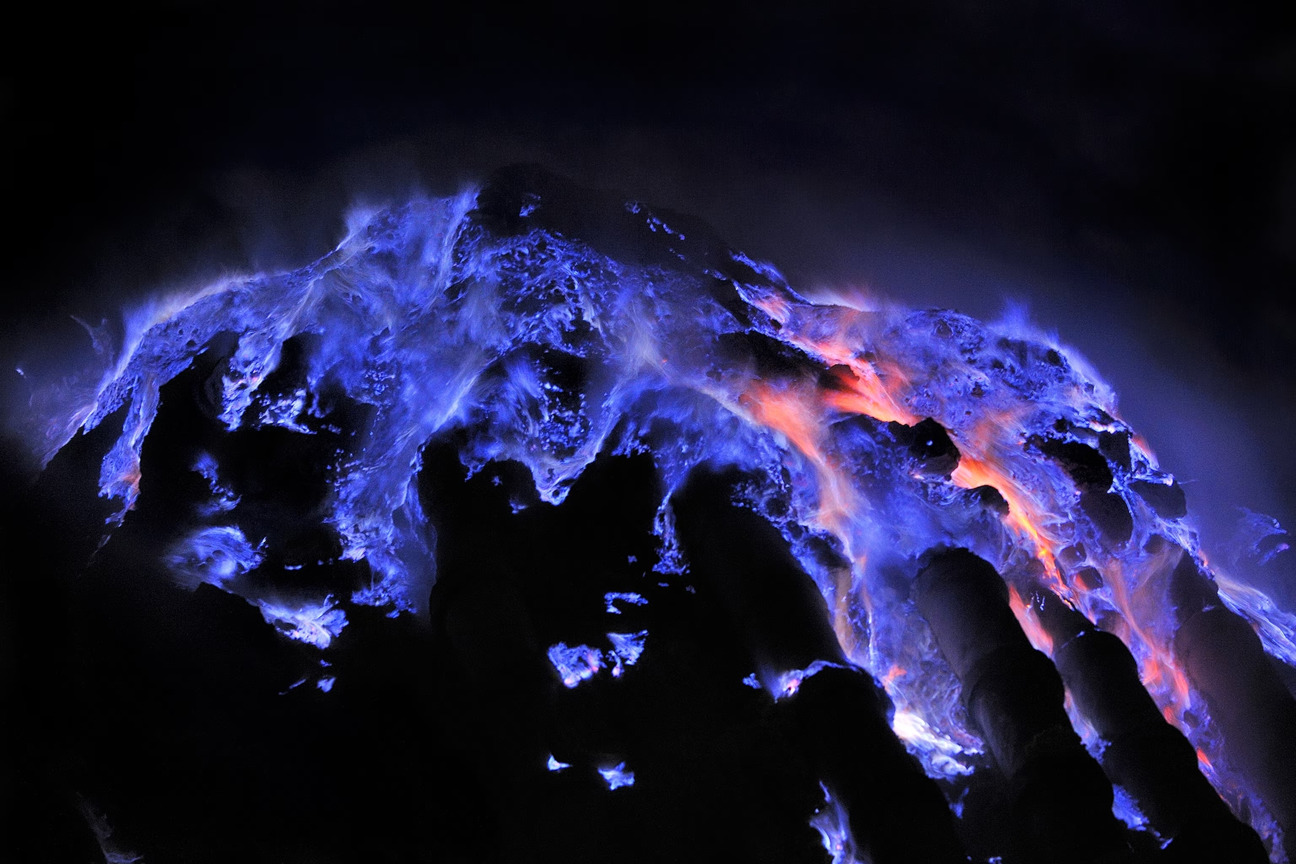
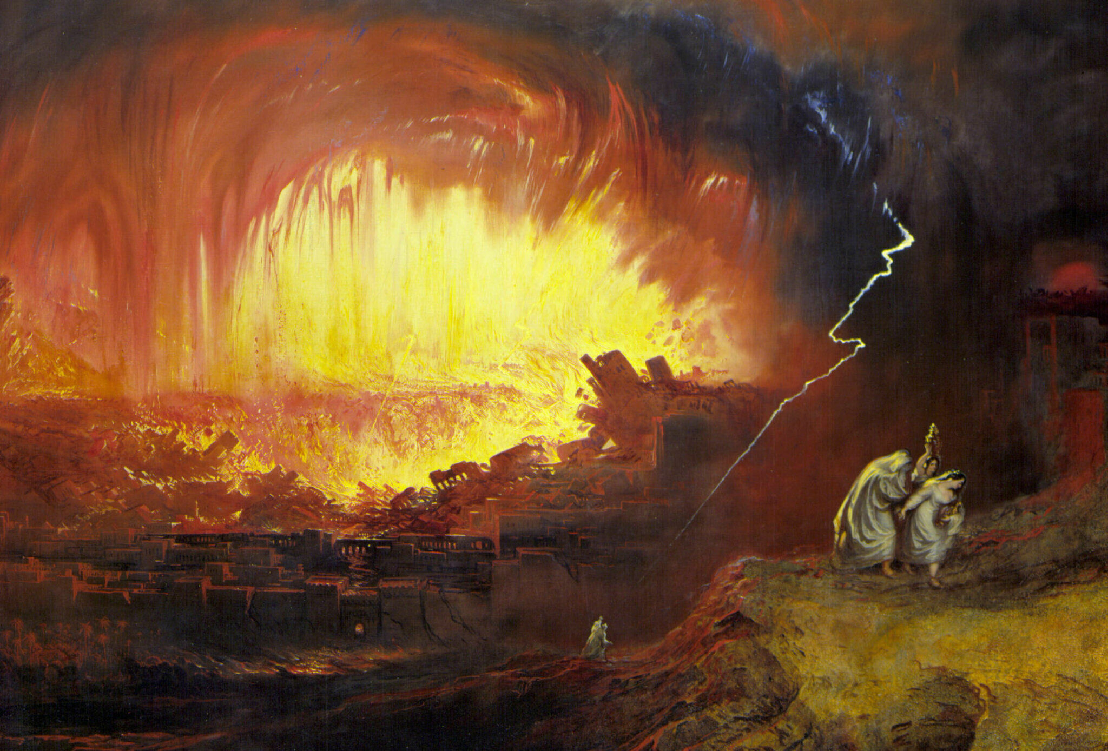
Sulfur and Fire Raining Down
John Martin’s “The Destruction of Sodom and Gomorrah” (1852)
Image Credit: Olivier Grunewald, National Geographic

Slide 9
CHAPTER 19 – God Destroys Sodom
Luke 17:28-32 (ESV)
28 Likewise, just as it was in the days of Lot—they were eating and drinking, buying and selling, planting and building, 29 but on the day when Lot went out from Sodom, fire and sulfur rained from heaven and destroyed them all— 30 so will it be on the day when the Son of Man is revealed. 31 On that day, let the one who is on the housetop, with his goods in the house, not come down to take them away, and likewise let the one who is in the field not turn back. 32 Remember Lot's wife.

Slide 10
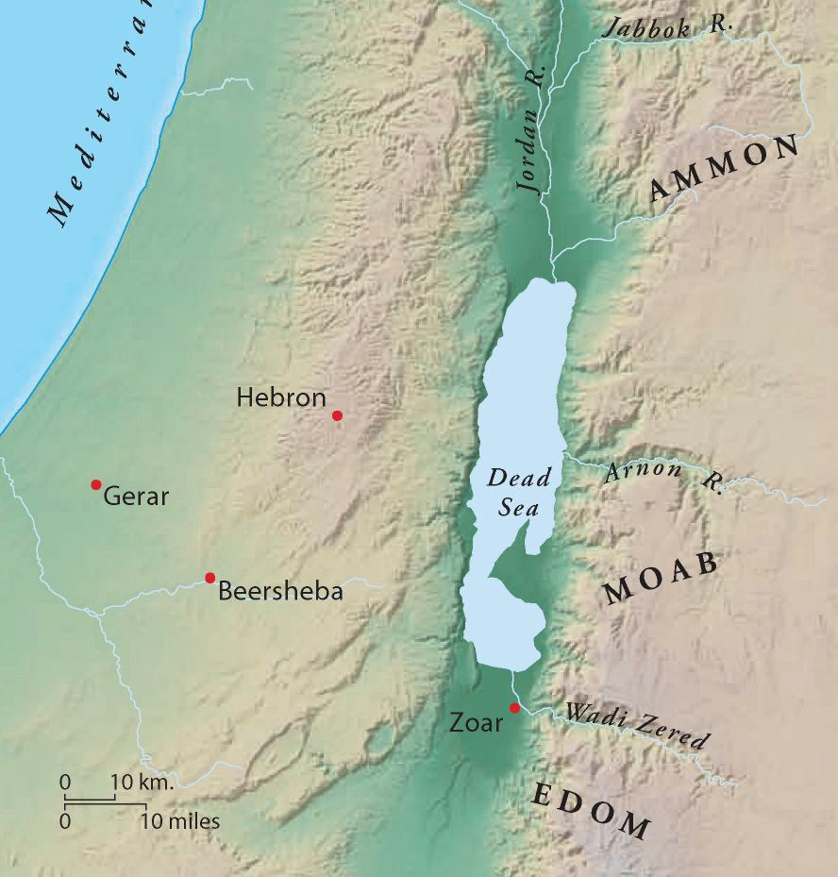
Moabites and Ammonites

Slide 11
Applications from Chapter 19
Evil influences corrupt good morals
We are in the world, but we must not be of the world
God is patient, but He will not overlook abominations
Judgement can be both cataclysmic (Sodom) and gradual (Lot’s family)
Don’t turn back toward what God has taken us away from
Any others?

