Slide 1
CHAPTER 20
Notes:
One of the things we talked about in the planning of the class was taking the opportunity to reinforce what we’re learning by doing a few drills along the way. We haven’t done much of that thus far, but I thought we could start off today’s class with testing our memory a bit.
I’ll mention a story or a character that we’ve studied, and you tell me what chapter of Genesis we find it in. But to spread the opportunity out and make it more interesting, the first one to answer correctly for each one doesn’t get to answer any more as we go along. So plan your answers wisely!
Tower of Babel – Chapter 11
Enoch walked with God – Chapter 5
Hagar bears Ishmael – Chapter 16
Adam and Eve sent out from the Garden of Eden – Chapter 3
Noah builds the ark – Chapter 6
Covenant of the Rainbow – Chapter 9
Abram becomes Abraham – Chapter 17
Abram receives a blessing from Melchizedek – Chapter 14
Cain murders Abel – Chapter 4
Abram returns from Egypt and separates from Lot – Chapter 13
God destroys Sodom and Gomorrah – Chapter 19
We ended Chapter 19 with Lot and his daughters, bearing children. This is the last time we hear anymore about Lot here in Genesis. Here in Chapter 20, we pick back up with Abraham.
20:1 – Now Abraham journeyed from there toward the land of the Negev, and settled between Kadesh and Shur; then he sojourned in Gerar.

Slide 2
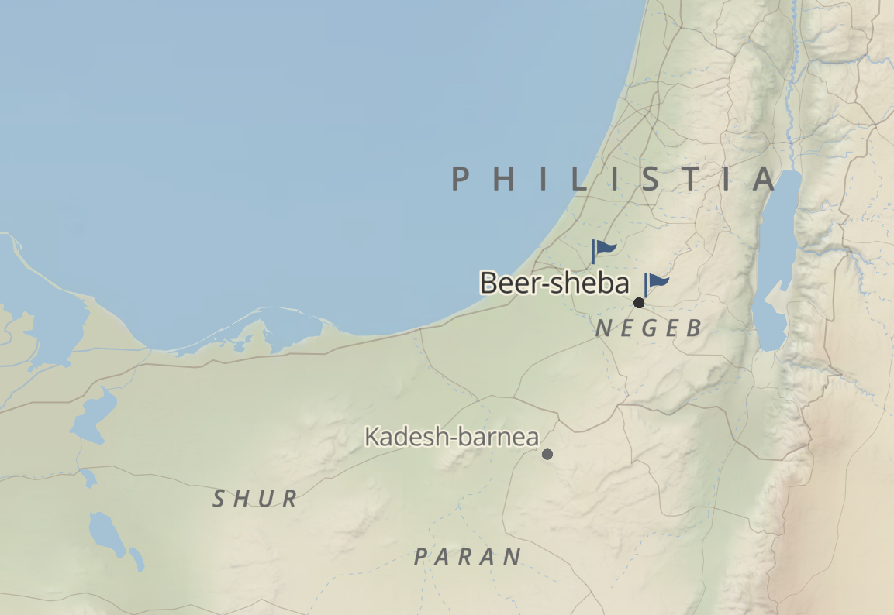
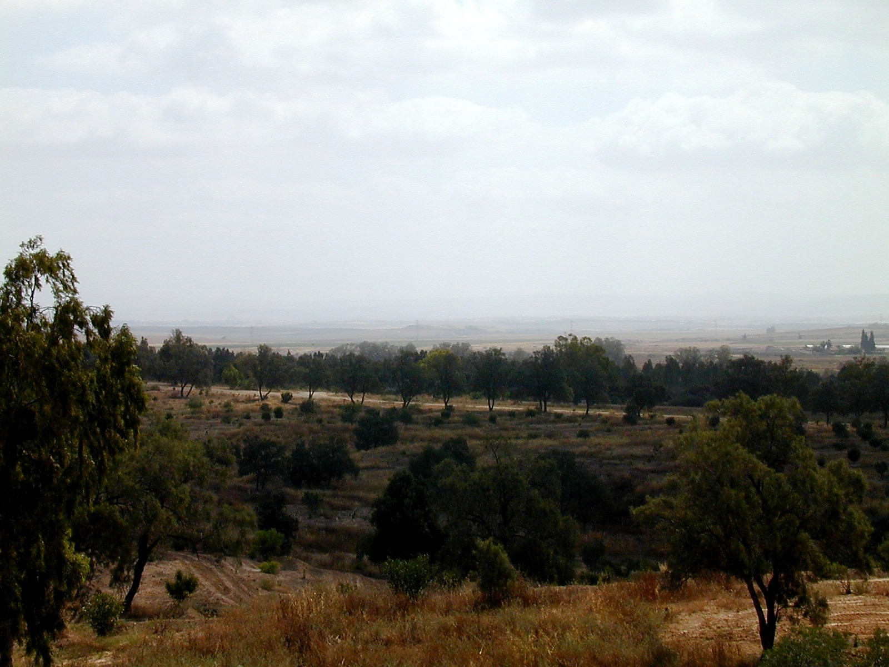
20.1, Abraham journeys to Gerar
Gerar. www.bibleplaces.com
Notes:
Here’s a map of the area, with a picture of what Gerar looks like. This was an area that was in a valley or ravine that would be dry except in the rainy season.
It’s not on this map, but coming from Mamre (or Hebron), would have taken him a little south, but mostly west, maybe 25-30 miles away, so maybe under the “T” in Philistia on this map. We have no reason given for why Abraham journeyed here, but from this point on, he will live in this region of Beer-sheba.
Now, when Abraham enters the land, he does something he’s done before – what is it? He says that Sarah is his sister (v2)
When was the last time he did this? Chapter 12. In Chapter 12, he’s going to Egypt – for what reason? Famine in the land.
And what happened to Sarah (Sarai at the time)? Word got to Pharoah that she was very beautiful and she was taken into his house.
Now Abraham benefited from this – he got sheep, oxen, donkeys, servants and camels.
What did Pharoah get out of the deal? He and his house got struck with “great plagues” (v 17).
How did that story end? Pharoah questioned Abraham (then Abram) – What is this you have done to me? Why did you not tell me that she was your wife? Why did you say, ‘She is my sister’, so that I took her for my wife?” And then Pharoah restored Sarai to Abram and told them to leave/had them escorted away.
Let’s follow the story this time and see how this goes.
V2 – Abraham said of Sarah his wife, “She is my sister.” So Abimelech king of Gerar sent and took Sarah.
By the way, why would Abimelech want to take Abraham’s sister as his wife? Abraham was probably well known at the time, and certainly others would have recognized his wealth, so its possible that Abimelech wanted to marry Abraham’s sister in order to have an alliance with him. Unlike the previous encounter with Pharoah, nothing is mentioned of Sarah’s beauty in this account.

Slide 3
20:3-8, God and Abimelech
V3 – “But God.. said to him, “Behold, you are a dead man because.. she is married.”
V4 – “Abimelech had not come near her… ‘blameless.. Integrity of my heart.. Innocence of my hands’
V6-7 – “God said.. I kept you from sinning against me.. restore her.. and you will live”
Notes:
V3 – But God came to Abimelech in a dream of the night, and said to him, “Behold, you are a dead man because of the woman whom you have taken, for she is married.”
Right off the bat, this is different from the encounter with the Pharoah – God directly intervenes in this situation and we have record of a pretty serious direct message to Abimelech. Can you imagine? Being a God-fearing person and having Him come to you in a dream to tell you that you’re going to die? Wow.
But Abimelech appeals to God – v4-5 – “Now Abimelech had not come near her; and he said, “Lord, will You slay a nation, even though blameless? Did he not himself say to me, ‘She is my sister’? And she herself said, ‘He is my brother.’ In the integrity of my heart and the innocence of my hands I have done this.”
Abimelech appeals to God’s justice here. We’ve recently studied another appeal to God’s justice – who made that appeal? Abraham himself, when trying to intercede for Sodom in chapter 18. But in this account, I think we can agree that Abimelech is being more righteous than Abraham here.
V6-7 – Then God said to him in the dream, “Yes, I know that in the integrity of your heart you have done this, and I also kept you from sinning against Me; therefore I did not let you touch her. Now therefore, restore the man’s wife, for he is a prophet, and he will pray for you and you will live. But if you do not restore her, know that you shall surely die, you and all who are yours.”
God recognizes that Abimelech had only good intentions, but also afflicted him in some way to prevent him from approaching Sarah. And we also see here that God calls Abraham a prophet.
Do you find it interesting that God uses this title here, in this circumstance? It might not have been evident to Abimelech, but it seems that through this deceit that Abraham might fall short of the esteem of being a “prophet” here. Especially in comparison to the last words we have from Abraham in chapter 18, where he’s intervening with God on behalf of Sodom.
What is a prophet? Basically, one who speaks on behalf of a deity. Someone who would be an inspired teach or proclaimer of the will of God. Now, we aren’t told when Abraham had specifically done this. It could have been when he relayed to others the promises God had made or the instruction of God to be circumcised??, but prophets were viewed as being able to both deliver the message from a god(s) and to intercede/make petition to the god(s) on behalf of others.
So while the title may not match the behavior we see in this story in our eyes, its clear that God will stand by those who serve him – Abraham here, and even Lot from the last chapter.

Slide 4
20:9-13, Abimelech questions Abraham
What did you do?
What did we do to you?
Why did you do this?
I assumed you didn’t fear God
It’s half true
It’s what we’ve always done
Notes:
V8 – So Abimelech arose early in the morning and called all his servants and told all these things in their hearing; and the men were greatly frightened.
V9 – Then Abimelech called Abraham and said to him, “What have you done to us? And how have I sinned against you, that you have brought on me and on my kingdom a great sin? You have done to me things that ought not to be done.
V10 – And Abimelech said to Abraham, “What have you encountered, that you have done this thing?”
Basically Abimelech asks: What did you do? What did we do to you? And Why did you do this?
These are great questions, because it really gets to the core of what Abraham did. Why did he do this? Fear for personal safety/being killed. Do you think this fear was justified? Possibly. But I think this shows us that, just like us, Abraham had a weakness or blind spot in his faith – his about his own personal safety.
And what did that blind spot cause him to do? Act in his own interest, with little regard for the impacts to others. He had to know there would be impacts, right? Think of the last time in Egypt – Pharaoh and his house were hit with great plagues. Abimelech here says “you have done to me things that ought not to be done”, and he was right. Abimelech himself is now in a life or death situation. And it wasn’t just Abimelech affected here - farther along in v18 “For the Lord had closed fast all the wombs of the household of Abimelech because of Sarah, Abraham’s wife.” What about Sarah? Being taken “captive” or without choice to be another man’s wife.
Can you think of a reason why Abraham should have been less afraid in this situation than before? From Chapter 18, the birth of a son named Isaac to Abraham and Sarah has been promised now, with a specific timetable (“next year” from 18:10, but time has passed, so this event is approaching). So it would have been reasonable to think that God would protect both Abraham and Sarah, given that God said he would fulfill this promise soon. On the other side, this approach worked for him in Egypt, so you can also see where this practice of his was reinforced in his mind.
How does Abraham respond to Abimelech? He gives 3 parts to his response.
V11 – Abraham said, “Because I thought, surely there is no fear of God in this place, and they will kill me because of my wife.
How do you think that might come across? This is off to a bad start – frankly, it could be seen as insulting. “I assumed you didn’t fear God.” From what you know, does this sound accurate? In the earlier verses we read, its clear Abimelech did fear God.
V12 - Besides, she actually is my sister, the daughter of my father, but not the daughter of my mother, and she became my wife;
This is the first time we become aware that Sarah could actually be considered Abraham’s sister. Even if this is true (and no reason think its not), what’s the problem here? It’s a half-truth. It’s meant to conceal their marriage relationship in favor of the lesser relationship they have as sharing a father. It just reminds me of someone using the excuse “I didn’t lie!”, when the real problem is that they didn’t tell the whole truth intentionally.
V13 - and it came about, when God caused me to wander from my father’s house, that I said to her, ‘This is the kindness which you will show to me: everywhere we go, say of me, “He is my brother.”’”
This was Abraham’s plan that they would follow when they journeyed. It’s what they did. It also has the air of some blame towards God, at least to me – “when God caused me to wander from my father’s house” I’d think most certainly that God didn’t instruct Abram/Abraham to be deceitful about Sarai/Sarah – this was something he came up with on his own.
So not much of an answer or defense from Abraham here.. Let’s see how Abimelech responds.

Slide 5
20:14-18, Righteousness and Restoration
V14 – Abimelech then.. gave.. to Abraham and restored his wife Sarah to him.
V15 – “Behold, my land is before you; settle wherever you please.”
V17 – Abraham prayed to God, and God healed Abimelech and his wife and his maids
Notes:
V14 – Abimelech then took sheep and oxen and male and female servants, and gave them to Abraham, and restored his wife Sarah to him.
So, as with the time in Egypt, Abraham receives both animals and servants, and Sarah is returned/restored. But a notable difference is that Abimelech gave these after he was afflicted, and perhaps notably, before he was healed. He also doesn’t verbally respond to Abraham’s reply to the questions he asked either. I doubt it was from Abraham’s answers being satisfactory, but more of a belief (or fear) of God and knowing what was at stake.
Also, unlike the Pharoah in chapter 12, in v15.
V15 – Abimelech said, “Behold, my land is before you; settle wherever you please.”
He does not make Abraham leave – Abraham remains welcome in the land.
V16 – To Sarah he said, “Behold, I have given your brother a thousand pieces of silver; behold, it is your vindication before all who are with you, and before all men you are cleared.”
Note that Abimelech refers to Abraham as Sarah’s “brother” here – perhaps said sarcastically. But the payment made was to ensure that Sarah’s reputation remained intact and would signal the family remained intact.
V17-18 – Abraham prayed to God, and God healed Abimelech and his wife and his maids, so that they bore children. For the Lord had closed fast all the wombs of the household of Abimelech because of Sarah, Abraham’s wife.
Abraham does as God said he would – prays for Abimelech, and whatever afflicted them was removed. Again, we see God keep his promises to those that fear him.
Who was more righteous here – Abraham or Abimelech? I’d say Abimelech - Not only did he seek Sarah for honest reasons, but he followed God’s instruction to save himself/his family and treated Abraham and Sarah extremely well after the Abraham’s deceit was discovered (in comparison to the Pharaoh). Whether it was custom or not, I would say that Abraham deserved none of the gifts of animals, servants or the silver based on his behavior and lack of thought about how his actions would affect others. Nonetheless, it was given to him.
_______
Let’s try to make some applications for us today.
First, how would you describe Abraham’s faith? While a man of great faith (leaving his home, believing in God’s promises, honoring his part of the covenant through circumcision, and others), his faith was not perfect – he had this fear for his personal safety, which led him to trust his own plans instead of trusting in God. It’s like Abraham trusts in God’s power to deliver on the big promises, but is concerned about the lesser things (personal protection) along the way. Israel also had this same problem – knowing that the Lord had delivered them from Egypt, but doubting his ability to provide for their hunger and thirst in the wilderness. Can’t we also get caught in the same trap? We can know and believe that God will save us and take care of us, but we get wrapped up in our own way of solving smaller problems along the way? We have an opportunity to take note of our own shortcomings/blindspots/fears and work to overcome by placing greater faith in the Lord.
What do we see about God here? He is faithful and will keep his promises, no matter what man throws in the way. He is the only one who can fulfill these promises, despite our efforts. One author said about this chapter – “on the brink of Isaac’s birth-story here is the very Promise put in jeopardy, traded away for personal safety. If it is ever to be fulfilled, it will owe very little to man. Morally as well as physically, it will clearly have to be achieved by the grace of God” (Derek Kidner)
What should we take from Abraham’s approach with Abimelech? Abraham assumed “surely there is no fear of God in this place” (v11). What a bad assumption, and one that really should have put Abraham in his place when all was said and done. The bible is filled with stories of people who looked at others and made the wrong assumption or judgment about them, and we have to be aware of that for us as well. It’s too easy to assume the merits or lack of merit someone may have based on our own view of things, but what should we do instead? Live godly lives and share the gospel with all.

Slide 6
Notes:
If needed:
What is something that you’ve picked up after re-reading/studying some of these stories in Genesis that stick out to you?

